Slide 1
Bronco Barbells
Data Analytics – Apache Spark
Project Report (Final)
Date: 11 March 2019
Team 1
Prachi Sharma
Prithviraj Naidu
Shruti Trivedi
Brett Castello
Kyle Wright
Ishu
Notes:
Title

Slide 2
Contents
About Us
Mission statement
Business Description
Project Description
Requirements
Identified OSS : Apache Spark
SDLC Model
Architecture approach
Project Roadmap
Test Plan and Release Criteria
ROI and ROV
Potential risks and management strategies
Annexure
Notes:
Average

Slide 3

About Bronco Barbells
We are an e-commerce company selling athletic training equipment across the US
We are ~150 employees strong and our customer base is expanding each year
Currently, we process up to 60,000 transactions per month on our website
We anticipate this number to increase rapidly in the next 6 months by ~20% MoM*
Source: For logo design - https://www.freelogodesign.org/
*MoM: Month on month
Notes:
Average

Slide 4

Mission Statement
“Deliver high quality athletic training equipment at an affordable price”
Source: For logo design - https://www.freelogodesign.org/
Notes:
Simple

Slide 5
Business description: Customer segmentation
Customer Segmentation
Our current customer base is divided into 2 major segments: Commercial and Individual.
Commercial
Individual
Gyms- Private chains, Corporate offices, Apartments/ Hotels ; Others- Yoga/ Chiropractor studios
Comprise ~75% of gross sales
Domestic/ individual users who purchase equipment for personal use at home
Constitute ~ 25% of gross sales
Source for both images: http://10minuteschool.com/professional/courses/starting-your-company/icon-enterprise/
Source for image: https://iconscout.com/icon/gym-34
Source for image: www.123rf.com/photo_64518984_stock-vector-vector-sport-and-fat-people-fitness-gym-color-flat-icon-workout-set-fat-people-fitness-gym-fat-exerc.html
Notes:
Average

Slide 6





Business description: Data Storage
Data storage: We use MySQL for data storage and currently store customer, product, inventory, transaction and revenue data.
Customer Profile & Demographics
Product
Transactions
Inventory
Data warehouse
Source for all icons: Icons taken from the ‘Insert-> Icons’ feature provided by MS PowerPoint
Reference for slide: https://exponea.com/us/blog/using-exponea-for-customer-acquisition-targeting-automation/
Notes:
Simple

Slide 7


Business description: Current analytics workflow
We perform analytics to classify customers into various deep segments in order to target them with promotional emails for customer acquisition and retention:
Data Analysts query the database for customer, transactions and product related data
Perform analytics and apply deep segmentation scheme to the customer base
Export the data into CSV file and forward to the Marketing Manager
Marketing Manager
Data Analysts
Data warehouse
Source for all icons: Icons taken from the ‘Insert-> Icons’ feature provided by MS PowerPoint
Reference for slide: https://exponea.com/us/blog/using-exponea-for-customer-acquisition-targeting-automation/
Notes:
The Analytics team extracts customer data, including customer profile, and transactional activities, and transforms these records into insights that can be used by Marketing team for developing customer acquisition and retention strategies.
Average slide

Slide 8
Organization Chart
CEO
Chief Marketing Officer
Chief Information Officer
Manager- Marketing
IT Team
Analytics Team
Business Development team
Technical Architect
Data Scientist
Data Analyst
Notes:
The Org Chart has been limited to represent only Marketing and IT departments since our business problem is centered around these departments.
Simple

Slide 9
Organization Chart – Roles and Responsibilities
Marketing Manager oversees business development efforts that target our commercial customers who comprise ~75% of current sales.
Chief Information officer oversees both IT and Analytics teams.
IT team is responsible for software development, maintenance, hardware and infrastructure management for the entire organization.
Analytics team is responsible for performing analytics on our current data and identify potential use cases as directed by Marketing team.
Notes:
Average

Slide 10
Project Description
Problems
Business objectives
Learning goals
Notes:
Title

Slide 11
Problems
Manual and time–consuming analytics
Current analytics process takes ~1 week due to the manual process of data retrieval and analysis
Lack of targeted product recommendations to customers
We are not effectively analyzing data about product features and customer preferences to be able to correlate the two and provide targeted recommendations to customers based on past purchases.
Source: vectorstock.com/13296382
References: Apache Spark Implementation on IBM z/OS;
Getting Started with Apache Spark, Inception to Production, James A. Scott, Copyright ˝ 2015 James A. Scott and MapR Technologies
Notes:
Through 4 years of operation, we have collected and analyzed decent amount of data to enable us to move in data driven way. However, the marketing team feels there are definitely opportunities to grow and expand.
Average

Slide 12
Problems
Customer behavior data is not captured
We are missing out on following information that every customer leaves behind when they visit our website:
Navigation history during a session
Cart history for products not purchased
Product browsing history of customer
Source: https://printmeposter.com/search/thoughts/1/poster_photo_260965282.html
Notes:
Simple

Slide 13
Technical Objectives
Reduce time and cost required for analytics and improve productivity through automation
Capture customer behavior on the website to improve analytical insights
Provide targeted product recommendations by transitioning from a reporting to an analytical model and help increase sales
Make data and analytics a centerpiece of marketing strategy
Source for image: https://www.vectorstock.com/royalty-free-vector/icon-flat-style-design-goal-setting-vector-7928544
Notes:
Average

Slide 14
Strategic Objectives
Build and scale advanced analytics competencies including data science and machine learning and incorporate them across functional areas of the company
Train the analytics team to enhance data modeling capabilities
Study parameters that help determine customer behavior to inform future analytical use cases
Source for image: https://www.ciberspring.com/marketing/strategy/
Identify risks associated with current infrastructure that can inform future infrastructure needs
Notes:
Average

Slide 15
Requirements Analysis
Business Requirements
Functional Requirements
Non-functional Requirements
Personas
User Stories
Notes:
Title

Slide 16
Business Requirements
1. Apache Spark Implementation: Implement Apache Spark over existing MySQL Database management system to automate data analytics capabilities
2. Capture customer behavior data
3. Recommendation Model: Provide product recommendations to customers using collaborative filtering technique
References: Apache Spark Implementation on IBM z/OS;
Getting Started with Apache Spark, Inception to Production, James A. Scott, Copyright ˝ 2015 James A. Scott and MapR Technologies
Notes:
Simple

Slide 17
Functional Requirements: Apache Spark Implementation
System should support a distributed cluster infrastructure for parallel data processing.
System should be compatible with and support existing development environments.
System should provide integrated, optimized, parallel access to existing data environments.
System should support packages that enable loading and manipulating structured data.
System should support SQL and Python languages for data manipulation.
System should be able to scale distributed data sources based on the size and volume of data.
References: Apache Spark Implementation on IBM z/OS;
Getting Started with Apache Spark, Inception to Production, James A. Scott, Copyright ˝ 2015 James A. Scott and MapR Technologies
Notes:
Complex

Slide 18
Functional Requirements: Recommendation model
System must enable Data Scientist to design algorithms to generate a latent feature model containing correlation among selected features.
System should enable model-based collaborative filtering of features.
System should support data extraction and manipulation within multiple data sets in the database.
System should be able to hold information in memory (cache) to support up to 20 iterations of the latent feature model at any instance.
System should support Machine Learning library and APIs to enable recommendation model development and implementation.
System should support offline/online model training and ingesting trained models for production.
References: Apache Spark Implementation on IBM z/OS;
Getting Started with Apache Spark, Inception to Production, James A. Scott, Copyright ˝ 2015 James A. Scott and MapR Technologies
Notes:
Complex

Slide 19
Functional Requirements: Capturing Customer Behavior Data
System must allow creation of new database schema to capture customer behavior data including:
Navigation history during a session
Cart history for products not purchased
Product browsing history of customer
System must integrate with existing data sources to allow data extraction.
Notes:
Average

Slide 20
Non-Functional Requirements
Performance
System must allow access to current transactional data and to historical data within the processing time specified by the Data Scientist.
The recommendation model can perform 20 iterations within 10 minutes with 30,000 records.
Model performs with precision score of at least 80% and recall score of at least 40%.*
Scalability
System should be able to scale the number of clusters required based on volume of data processed.
System should provide scalable libraries to support machine learning models and algorithms.
References: * https://medium.com/@m_n_malaeb/recall-and-precision-at-k-for-recommender-systems-618483226c54
Notes:
Average

Slide 21
Non-Functional Requirements
Extensibility
Systems should have the capability to support injection of new data sets into the database from various external data sources and data processing environments.
System should serve as a complimentary approach to the data processing challenges, without altering procedures, policies, and/or existing programmatic approaches that are currently deployed.
References: Apache Spark Implementation on IBM z/OS;
Getting Started with Apache Spark, Inception to Production, James A. Scott, Copyright ˝ 2015 James A. Scott and MapR Technologies
Notes:
Average

Slide 22
Personas
Notes:
Title

Slide 23
Marketing Manager
Has 10+ years of experience in business development
Metrics-oriented and uses analytics to determine strategy for business development
Actively monitors data presented by the analytics team
Serves as a domain expert to define the data to be captured and types of analytics to be performed
Source for image: https://depositphotos.com/202318422/stock-illustration-presentation-flat-icon-female-business.html
Goals:
Increase current customer base through data-driven business development strategies
Develop ways to improve the customer experience and increase customer retention on the website
Increase sales by targeting right products to the right customers
Needs:
Reduce turn around time in sending targeted, promotional communication to customers from 1 week to 1 day
Improve targeting by providing relevant product recommendations through data analysis
Notes:
Average

Slide 24
Technology Architect
Has 10+yrs of IT experience in implementing Big data solutions
Responsible for designing and planning the implementation of new systems and technology
He has a big interest in new and emerging technologies and can easily plan for the future to develop technology solutions for business processes using his logical thinking
Source for image: https://www.hocu.ba/index.php/hocu.priliku/authority-partners-zaposljava-u-sarajevu-software-architect/
Goals:
Define and lead the realization of the data strategy roadmap for data modeling, implementation and data management
Configure Spark Server and embed advanced analytics into infrastructure using Spark
Needs:
Existing infrastructure should be compatible with Apache Spark’s environment
Notes:
Average

Slide 25
Data Scientist
Responsible for creating various machine learning-based tools such as recommendation engines.
Expert in performing statistical modeling and analysis.
Proactively fetches data from various sources and analyzes it for better understanding about business processes, and builds tools that automate processes within the company.
Source for image: https://www.rtafleet.com/easier-job-design/
Goals:
Develop product recommendation model to explore the customer and product data and create insights that have business value. Works with the Technology Architect and Data Analyst to create the schema for the processed data that the model will act upon.
Identify patterns, trends, risks, and opportunities in data captured
Discover new actionable insights
Needs:
Spark’s support on entire data science workflow, from data access and integration, to machine learning.
Library of machine-learning algorithms
Notes:
Average

Slide 26
Data Analyst
Responsible for managing the master data set, developing reports and troubleshooting data issues
Analyses data related to sales, market research, inventory, etc.
Has technical expertise to ensure quality and accuracy of data, and works with the Data Scientist to process and present the data to Marketing team
Source for image: http://www.singlemaltsdirect.com/web/index.php?uid=data-analys
Goals:
Capture customer behavior on the website to help improve analytical insights for the Marketing team
Needs:
Create new schemas for capturing new data
Apache Spark to run seamlessly over existing MySQL Database management system to ensure smooth data flow
Notes:
Average

Slide 27
User stories
Notes:
Title

Slide 28
User Stories: Marketing Manager
As Marketing Manager, I want reduced turn around time for analytics from 1 week to 1 day, so that I can send targeted communication to customers every day.
Acceptance Criteria
Turn around time for performing analytics for segmentation of customers is 1 day.
As a Marketing Manager, I want a % customer- product match score to target customers with high match scores for certain products, so that I can increase the landing page conversion rate on our website from 3% to 5% within 6 months.
Acceptance Criteria
1. Customer-product match score is available as a % score from the recommendation model.
2. Landing page conversion rate increases to 5%, +/- 0.5% acceptable after 6 months from deployment of the recommendation model.
References: Apache Spark Implementation on IBM z/OS;
Getting Started with Apache Spark, Inception to Production, James A. Scott, Copyright ˝ 2015 James A. Scott and MapR Technologies
https://searchengineland.com/7-conversion-rate-truths-will-change-landing-page-optimization-strategy-191083
Notes:
Complex

Slide 29
User Stories: Data Analyst
As a Data Analyst, I want to be able to capture and process data regarding customer behavior in order to help the business development team understand parameters affecting customer purchases.
Acceptance Criteria
Following data parameters are captured and are accurate:
Customer navigation history during a session
Customer’s cart history for products not purchased
Product browsing history of customer
As a Data Analyst, I want to export the customer-product match scores generated from the recommendation model into a csv file, so that I can provide this data to the Marketing team everyday.
Acceptance Criteria
Customer-product match scores generated from the recommendation model can be exported into a csv file.
Notes:
Complex

Slide 30
User Stories: Data Scientist
As a Data Scientist, I want to be able to load data into data frames so that I can perform transformations and actions on the dataset without any loss of data during analysis.
Acceptance Criteria:
1. Dataframes are supported and data can be successfully loaded into a dataframe.
2. Data integrity is maintained and no loss of data occurs during data loading and transformation.
As a Data Scientist, I want to develop an Alternating Least Squares (ALS) Algorithm to generate a latent feature model with customer’s personal, demographic, behavioral and transactional data and product features including brand, average customer rating and frequency of products brought together.
Acceptance Criteria:
1. Customer and product features are available in the datastores and can be loaded.
2. ALS is supported by the Machine Learning library.
References: https://towardsdatascience.com/prototyping-a-recommender-system-step-by-step-part-2-alternating-least-square-als-matrix-4a76c58714a1
Notes:
Complex

Slide 31
User Stories: Data Scientist
As a Data Scientist, I want the machine learning model to predict % match score for customers, so that I can identify customer- product relationships with highest match scores.
Acceptance Criteria:
Match score is predicted as a percentage score for each customer and product.
As a Data Scientist, I want the model to be updated with new data from the website every day, so that the for the most current data.
Acceptance Criteria:
1. New transactions on the website are updated in the datastore through scheduled queries that run every day at 00:00 PST.
2. Revised prediction scores are calculated based on the new data.
Notes:
Complex

Slide 32
User Stories: Data Scientist
As a Data Scientist, if required, I want to update the model parameters every 3 months to accommodate new features so that I can improve performance of the model.
Acceptance Criteria:
1. Model performance is measured by increase in last known accuracy score and recall scores by 1%.
Notes:
Simple

Slide 33
User Stories: Technical Architect
As a Technical Architect I want to setup Spark Execution Engine so that I can have a redundant system consisting of master and worker nodes.
Assumptions:
1. Number of nodes depends on the volume of data processed and can be scaled based on changes in volume.*
Acceptance Criteria
1. Each node offers redundancy per piece of data.
2. The Master node is able to distribute the data across all worker nodes.
Notes:
*Reference for number of nodes is specified in back up slide 95
Average slide

Slide 34
User Stories: Technical Architect
As a Technical Architect, I want to initialize a cluster that is sized to 44 nodes* in order to run scheduled queries to retrieve customer and transaction data for the recommendation model every day.
Assumptions:
1. Sizing of the cluster is dependent on volume of data being analyzed and will evolve to render real-time analysis on customer data.
2. Some triggered queries will not be real time and will be one off jobs.
Acceptance Criteria:
1. The leased space is cloud based.
2. The lease is not more than 6 months so resizing can be done according to the size of the data.
*Reference for number of nodes is specified in back up slide 95
Notes:
Triggered query is a one-off query performed for special data extraction; Scheduled query is performed daily for updating data stores with data generated on the website.
Average

Slide 35
Identified OSS: Apache Spark
OSS Introduction
Upstream and downstream projects
Contributors, Committers and Sponsors
Comparison with other OSS options: Hadoop
Notes:
Title

Slide 36
Apache Spark: Introduction
Apache Spark is a unified analytics engine for large-scale data processing
It is supported by Apache Spark Foundation, a not-for-profit OS software foundation
Spark has one of the largest open source communities in big data, with over 1000 contributors from 250+ organizations (Reference: https://databricks.com/company/about-us)
Source for logo: https://spark.apache.org/
Source for logo: https://www.apache.org/
Sources: https://spark.apache.org/ ; https://databricks.com/company/about-us
Notes:
Simple

Slide 37




Apache Spark: Features
Speed
Generality
Provides high performance by 100x faster runtimes*
Libraries for SQL & DataFrames, machine learning and GraphX
Ease of Use
Portability
Runs on multiple platforms including Hadoop, standalone and in cloud.
APIs available in SQL, R, Python, and Scala
Source: https://spark.apache.org/
Notes:
*Runtimes compared with Hadoop on logistic regression. Data taken from spark.apache.org.
SImple

Slide 38

Upstream and Downstream projects
Upstream
Source: https://spark.apache.org/history.html
Apache Spark started as a research project at the UC Berkeley AMPLab in 2009
Open sourced in early 2010
Moved to the Apache Software Foundation in 2013
Downstream
Source: http://spark.apache.org/powered-by.html
Source for logo: https://databricks.com/company/about-us
Source for logo: https://amplab.cs.berkeley.edu/
Formed by creators of Apache Spark
Provide cloud optimized platform to run Spark and ML on AWS and Azure
Source for logo: https://www.rondhuit.com/
Machine Learning with Apache Mahout and Spark
Sources: https://spark.apache.org/history.html;
http://spark.apache.org/powered-by.html
Notes:
Average

Slide 39
Contributors
Contributing to Spark isn’t limited to writing code.
Contributors make a difference in numerous ways including:
helping new users on the mailing list,
testing releases,
user libraries to Spark,
bug reports
improving documentation
Source: https://spark.apache.org/contributing.html,
Notes:
Simple

Slide 40
Committers
New committers are added from the active contributors, based on their contributions to Spark.
The qualifications for new committers include:
Sustained contributions to Spark
Quality of contributions
Community involvement
Apache spark currently has 68 committers from numerous organizations like Databricks, Facebook, Google, UC Berkeley, Cloudera etc.
Source: https://spark.apache.org/committers.html
Notes:
Simple

Slide 41


Sponsors
Source: https://www.apache.org/foundation/thanks.html
Notes:
Simple

Slide 42
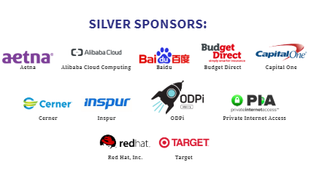
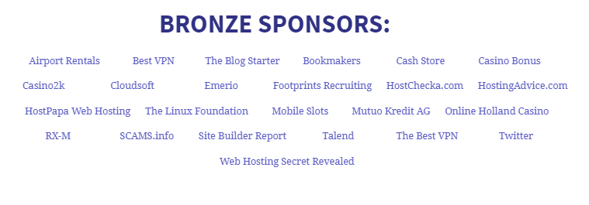
Sponsors
Source: https://www.apache.org/foundation/thanks.html
Notes:
Simple

Slide 43
Comparison with other OSS options: Hadoop
Parameters | Spark | Hadoop
Performance | Faster, in-memory processing provides real-time analytics including machine learning models | Slower processing speed due to batch processing and use of disk over memory
Ease of Use | User friendly APIs in Python and Spark SQL; Machine Learning library for developing and running machine learning applications | Uses Mahout for machine learning; Can lead to additional training costs
References: https://www.datamation.com/data-center/hadoop-vs.-spark-the-new-age-of-big-data.html; https://logz.io/blog/hadoop-vs-spark/; https://www.datamation.com/data-center/hadoop-vs.-spark-the-new-age-of-big-data.html
Notes:
Complex

Slide 44
Comparison with other OSS options: Hadoop
Parameters | Spark | Hadoop
Costs | Requires RAM space but fewer investment in systems for cluster management; reducing long– term costs | Requires significant hardware investment for disk space and to distribute the disk I/O over multiple systems
Data Processing | Single- step and in memory processing leading to faster query processing; Also provides GraphX, a graph computation library to view data as graphs and collections | Batch- processing; Sequential and less scope for query optimization
References: https://www.datamation.com/data-center/hadoop-vs.-spark-the-new-age-of-big-data.html; https://logz.io/blog/hadoop-vs-spark/; https://www.datamation.com/data-center/hadoop-vs.-spark-the-new-age-of-big-data.html
Notes:
Complex

Slide 45
Comparison with other OSS options: Hadoop
Parameters | Spark | Hadoop
Fault Tolerance | Uses RDDs which can operate in parallel and reference a dataset in an external storage system. RDDs are persistent ensuring 10x faster future actions on datasets Fault tolerant cache that can be automatically recomputed on failure | Significantly higher operation times in events of node failures
References: https://www.datamation.com/data-center/hadoop-vs.-spark-the-new-age-of-big-data.html; https://logz.io/blog/hadoop-vs-spark/; https://www.datamation.com/data-center/hadoop-vs.-spark-the-new-age-of-big-data.html
Notes:
Complex

Slide 46
Comparison with other OSS options: Hadoop
Parameters | Spark | Hadoop
Real-time Analysis | Spark can process data coming from the real-time event streams at the rate of millions of events per second | MapReduce fails when it comes to real-time data processing as it is designed to perform batch processing on voluminous amounts of data
When to Use | Fast and interactive data processing Graph processing Joining Datasets Iterative jobs Real time processing Machine Learning | Batch Processing of large Dataset No intermediate Solution required
Reference: https://medium.com/@chandu_22532/apache-hadoop-vs-apache-spark-e584fe2616f9
Notes:
Complex

Slide 47
SDLC Model
SDLC model
Notes:
Title

Slide 48
SDLC Model: Incremental development model
We propose an incremental model with implementation of Apache Spark as the 1st increment, and capturing new customer data and development of recommendation models and as increments that can be started in parallel by separate teams.
Each increment has a different software development model based on user stories that will be taken up by the respective teams.
Increment schedules will be included in the high level project plan.
Notes:
Simple

Slide 49
SDLC Model: Incremental development model
Increment 1
Apache Spark implementation
Waterfall model
Increment 2
Capturing customer behavior data
Lean model
Increment 3
Developing recommendation model
Xtreme programming
Notes:
Simple

Slide 50
Increment 1: Apache Spark implementation
SDLC Model: Waterfall model
Reasons:
Organization wide impact on infrastructure (hardware for cluster management etc.)
Demands detailed analysis of requirements along with identification of critical modules
Need to finalize design specifications before implementation
Notes:
Average

Slide 51
Increment 1: Apache Spark implementation
Waterfall model
Team: IT Team
Major activities:
Integrate Apache Spark over existing MySQL
Use Spark to design an analytics engine which can answer queries related to current reporting over database
Source for image: https://airbrake.io/blog/sdlc/waterfall-model
Notes:
Average

Slide 52
Increment 2: Capturing customer behavior data
Lean model
Reason:
Customer centric: Need full validation from marketing on features to be captured
Need to identify and eliminate risks in capturing new data
Quick turnaround in data processing for key business partners
Notes:
Average

Slide 53
Increment 2: Capturing customer behavior data
Lean model
Team: Analytics team (Data Analysts)
Major activities:
Add schema in existing database to store information about user
navigation and searches
Identify potential schema changes to capture data such as: items added to cart, inclusive of those that did not end up in purchase but were added in cart at-least once
Capture geographic information of customer
Source for image: https://photosgratuite.eu/knowledge-management-is-a-discipline.html
Notes:
Average

Slide 54
Increment 3: Developing recommendation model
SDLC Model: Xtreme programming
Reason:
Need prototype models to identify what parameters impact model performance
Need inputs from marketing team in improving understanding of parameters
Test driven approach to determine highest performing parameters
Buddy system to act as a sounding board during model development and testing
Notes:
Average

Slide 55
Increment 3: Developing recommendation model
Xtreme programming
Team: Analytics team (Data Scientists)
Major activities:
Develop prototype models using ALS algorithm
Deploy the final recommendation model
Source for image: http://josecuellar.net/extreme-programming-principles/
Notes:
Simple

Slide 56
Architecture Approach
Current architecture
Proposed architecture
High level design
Low level design
Relevant areas for the project
Notes:
Title

Slide 57



Current Architecture
Data stores
Analytics team
Customer
Product
Transactions
Data is stored in MySQL database
Data is extracted by the Analytics team for analytics and reporting
Inventory
MySQL Database
Reference : https://exponea.com/us/blog/using-exponea-for-customer-acquisition-targeting-automation/
Notes:
Simple

Slide 58
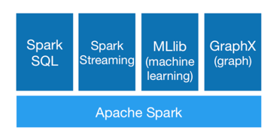
Apache Spark Architecture
Spark supports use of Python and SparkSQL (Reference: https://spark.apache.org/sql/)
Spark SQL includes a cost-based optimizer, columnar storage and code generation to make queries fast.¹¹
Scales to thousands of nodes and multi hour queries using the Spark engine, which provides full mid-query fault tolerance. ¹¹
Supports a different engine for historical data.¹¹
Manipulates complex distributed mapped relational queries¹¹
Source for image: http://spark.apache.org/
Reference: https://spark.apache.org/sql/
Notes:
Complex

Slide 59
Proposed Architecture
Customer
Dataset API
DataFrame API
Catalyst Optimizer
Analytics
Team
Spark Core Execution Engine
Product
Resilient Distributed Datasets (RDDs)
Spark Execution Engine
Transactions
Inventory
MySQL Database
Datastores
References : https://exponea.com/us/blog/using-exponea-for-customer-acquisition-targeting-automation/
https://medium.com/@manuelmourato25/how-spark-dataframe-shuffling-can-hurt-your-partitioning-28d05fdcb6fa
https://subscription.packtpub.com/book/big_data_and_business_intelligence/9781785884696/4/ch04lvl1sec26/architecture-of-spark-sql
Notes:
Average

Slide 60
Proposed architecture approach
N-Tier Architecture approach
Spark Core Execution Engine will sit on top of the SQL Database.
Analytics team will use Dataframe APIs to access data from the SQL database through Spark.
Spark Execution Engine will consist of RDD clusters to enable distributed data processing.
Notes:
Simple

Slide 61
High level design
Guiding principles
Design for Extensibility
Ability to incorporate new analytical use cases
Ingest data from new data sets and data sources in the future
Design for Testing
Continuously assess and update machine learning models
Incorporate new attributes into the schema
Reference: Software Project Management, Class notes Feb 21- Design
Notes:
Average

Slide 62
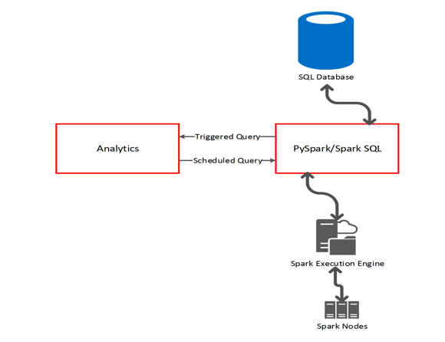
High level design
Data Analyst or Data Scientist will fire scheduled or triggered queries to the system
Query will be directed to Spark SQL/ PySpark which will send it to Spark Execution Engine
Note: Architecture design created using Microsoft Visio
Notes:
Average

Slide 63
High level design
Spark Execution Engine will monitor spark jobs performed by the master/node clusters.
Result will be returned back to the user and can be stored in an database.
Note: Architecture design created using Microsoft Visio
Notes:
Average

Slide 64
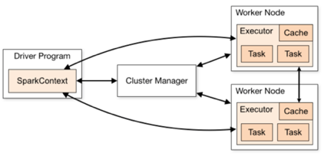
Low level design: Cluster Management
Apache Spark Cluster Mode Overview
Source for image: https://spark.apache.org/docs/latest/cluster-overview.html
Spark Driver Program ( Main program) contains Spark Context
SparkContext connects to Cluster Managers which allocate resources across applications
Executor processes run application code for computations and store data
Source: https://spark.apache.org/docs/latest/cluster-overview.html
Notes:
Average

Slide 65
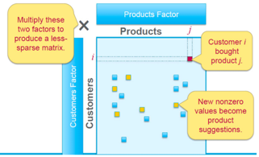
Low level design: Recommendation model
Source for image: https://medium.com/@m_n_malaeb/recall-and-precision-at-k-for-recommender-systems-618483226c54
Source for image: Apache Spark Implementation on IBM z/OS
Notes:
Average

Slide 66
Project roadmap
Notes:
Title

Slide 67
High level road map
Note: Numbers in the boxes signify number of days
Notes:
Gantt chart for project tasks without considering weekends
Average

Slide 68
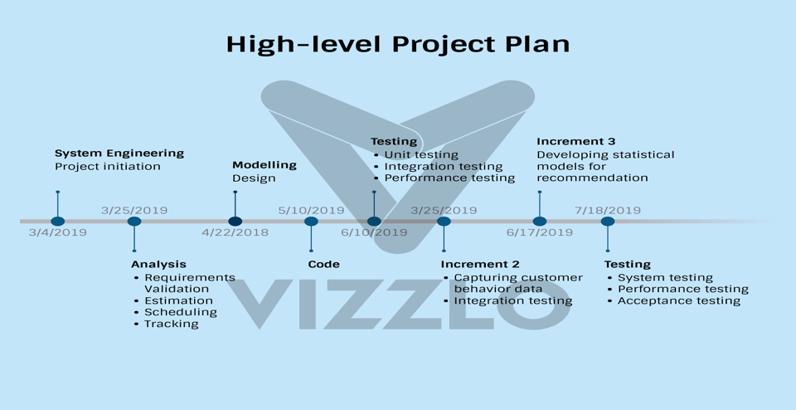
High level road map
Source: Diagram created from vizzlo.com
Notes:
Represents the start date of project tasks
Average

Slide 69
Test Plan and Release metrics
Test Plan
Release Metrics
Notes:
Title

Slide 70
Test Plan
Test plan will comprise of:
Unit testing
Integration testing
System testing: Performance and Stress testing
User Acceptance testing
Source for image: https://infotors.in/testing.php
Reference: Software Project Management, Class notes Feb 28- Testing
Notes:
Simple

Slide 71
Unit testing
Functional Testing
Ensure all packages are installed
White box testing for machine learning algorithm code
Identify potential schema changes to capture data such as: items added to cart, inclusive of those that did not end up in purchase but were added in cart at-least once
Non-Functional Testing:
Measure speed of data loading
Analyze statistics on speed and volume of data flow
Reference: Software Project Management, Class notes Feb 28- Testing
Notes:
Average

Slide 72
Integration & System Testing
Post unit testing, we will focus on integration and system testing. This stage will test for any decrease in system performance & whether Apache Spark is compatible with the current system structure and ensures uninterrupted data flow.
Data workflow testing: End to end ETL activities can be performed with 100% success.
Fault-tolerant testing: Ensure Spark job executes almost entirely on CPU, not causing any significant activity of shuffle and/or disk read/write, as expected.
Ad-hoc testing to test for any impact any existing workflows.
References: Software Project Management, Class notes Feb 28- Testing;
https://www.guru99.com/system-integration-testing.html
Notes:
Average

Slide 73
Performance Tests
Query processing times will vary and hence will be determined for scheduled and triggered queries based on*:
Number of records accessed
Number of nodes running in parallel depending on the volume of data
Model performance will be tested separately for following scenarios:
Training and testing model performance before deployment
Model performance post deployment
Environment
Spark 2.3.2
Acceptance Criteria
+/- 1 second over specified time is acceptable
Pass/Fail
Reference: Software Project Management, Class notes Feb 28- Testing
Notes:
*Expected query execution time will be decided for each type of query by the Data Scientist and documented in the test cases.
Average

Slide 74
Stress Tests
Test the systems failure point and maximum performance
Requirements Verification
Master Node offers replication factor of 5 to offer a high level of redundancy.
100 terabytes of data will be analyzed to ensure the ability of the master node to separate RDD's
Environment
Spark 2.3.2
Acceptance Criteria
Pass/Fail
Reference: Software Project Management, Class notes Feb 28- Testing
Notes:
Average

Slide 75
User Acceptance testing
Post performance testing, the project will include Final acceptance tests that will check for :
Whether the developed system runs seamlessly without disrupting any existing process
The developed system enables query processing on current Database setup as well as on the new analytics engine for capturing customer and product data.
Following data parameters are captured:
customer navigation history during a session
customer’s cart history for products not purchased
product browsing history of customer
Reference: Software Project Management, Class notes Feb 28- Testing
Notes:
Average

Slide 76
Release Criteria
All high severity bugs found in the testing phase should be resolved, tested and documented.
Ensure data flow testing passes with success.
Zero RDD failure: Fault tolerant cache is automatically recomputed on failure.
All User Acceptance Tests must pass with success.
Source: https://www.onlinewebfonts.com/icon/333338
Reference: Software Project Management, Class notes Mar 7
Notes:
Average

Slide 77
Risks
Scope Creep
Communication Breakdown
Loss of Skillsets
Under/ over estimation
Environment Disaster
Notes:
Title

Slide 78
Scope Creep
Description: Requirements exceeds available velocity of the project.
Severity: Medium
Impact: Set the schedule off target, cause of delays in implementation or releasing analytical metrics
Priority: 3
Avoid: Estimate velocity of the increment correctly
Mitigate: Pull back features/tasks that are unnecessary to avoid delay
Notes:
Average

Slide 79
Communication Breakdown
Description: Misunderstood requirements, invalid feedback from the business partners
Severity: High
Impact: Confliction between teams, delays in increment deliverables
Priority: 1
Avoid: Have predetermined avenues of communication including a strong change management process
Mitigate: Communicate issues/roadblocks throughout each increment
Notes:
Average

Slide 80
Loss of Skillsets
Description: Potential impact from a learning curve; missing team member
Severity: Low
Impact: Inability to allocate resources, Increased resource cost
Priority: 4
Avoid: Have a well rounded team where each team member has another team member as a back up to their role
Mitigate: Place these items in the schedule and constantly work on team-effectiveness
Notes:
Average

Slide 81
Under/Over-Estimation
Description: Overload of requirements or inaccurate schedule estimation
Severity: High
Impact: Scope creep, missed deadlines, project delay, LAG/PAD causes further delays
Priority: 2
Avoid: Use past project and similar user stories in scheduling and requirements gathering
Mitigate: If delays or lag is noticed, adjust schedule accordingly
Notes:
Average

Slide 82
Environment Disaster
Description: Natural disaster or economic crisis leading to a threat to physical resources/ infrastructure
Severity: Low
Impact: Destruction of Clusters/Database
Priority: 5
Avoid: Use a cloud based architecture in different regions for redundancy
Mitigate: Hold back ups of data at multiple locations
Notes:
Average

Slide 83
Key software performance areas
SWOT
ROI
ROV
Notes:
Title

Slide 84
Strengths
Current analytical use cases
Domain expertise
Experienced Data Scientists and Technical Architect
Strengths
Notes:
Simple

Slide 85
Weaknesses
Implementing new technology not attempted before
Source for image: https://www.chess.com/article/view/finding-your-real-weaknesses
Increased learning curve
Notes:
Simple

Slide 86
Opportunities
Recommendations for customers
New analytical use cases
Scalability
System performance improvement
Source for image: http://rishikajain.com/2014/05/24/top-ten-famous-quotes-on-opportunities/
Notes:
Simple

Slide 87
Threats
Data integration issues
Potential security threat by moving data to cloud
Source for image: https://www.bankinfosecurity.com/webinars/live-webinar-stronger-privileged-account-protection-new-role-threat-w-1536
Notes:
Simple

Slide 88
Return on Investment
Benefits:
Annual savings through reduction in man-hours for analytics: ~ $ 72,692
Projected increase in sales for 1st year*: ~ $ 2,790,000
Costs:
Training: ~$ 9,000
Licensing Costs: $ 0
Hardware Costs (Cloud hosting with AWS): ~$ 4,800
Projected Costs: ~ $ 13,800
ROI over 1 year:
Estimated Benefits –Costs = $ 2,862,692 - $ 13,800 = ~$ 2,848,990
Source: https://go.thoughtspot.com/webinar-ovum-quantifying-roi-of-search-driven-analytics.html
*Detailed calculations of costs and benefits provided in back up slides 96,97
Notes:
Since project execution time is 6 months, for 1st year projected sales calculated for 6 month period and an average of 1% increase in sales considered.
Average

Slide 89
Return on Value
Value for Customers
Decreased turn around times for customer communication
Increased customer engagement alongside expanding customer base
Source for image: https://marketingland.com/value-props-customer-competitive-research-shape-marketing-236117
Notes:
Simple

Slide 90
Return on Value
Value for the company
Promotes organizational learning with incorporation of newer analytical platforms
Productive use of analytics manpower and resources
Promotes data-driven decision making across the organization
Source for image: https://merger.com/company-scalability-really/
Notes:
Simple

Slide 91
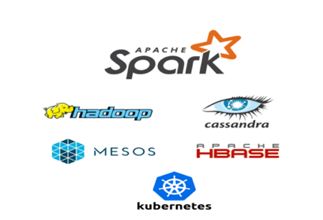
Return on Value
Enables organizational growth
Generates potential for tapping into existing customer data that can result in development of analytical use cases in the future
Spark’ compatibility across platforms promotes scalability in the future
Source for image: http://spark.apache.org/
Notes:
Simple

Slide 92
Annexure
Notes:
Title

Slide 93
About Apache Spark Foundation (ASF)¹
ASF is the world's largest Open Source foundation which develops, incubates, and shepherds 300+ freely-available, enterprise-grade projects that serve as the backbone for some of the most visible and widely used applications in computing today at 100% no cost.
Applications that are "Powered by Apache" include:
➔ 80M+ Websites that use the Apache HTTP Server;
➔ 2.6-terabyte, Pulitzer Prize-winning Panama Papers investigation;
➔ tracking 42,750 daily flights at the US Federal Aviation Administration;
➔ 500+B daily event capture at Netflix;
➔ 4+B mobile device platforms worldwide;
➔ request processing at Facebook’s 300-petabyte data warehouse;
➔ clouds for Apple, Disney, Huawei, Tata,
Source: 1. Apache Spark Foundation Annual Report, FY 2018
Notes:
Backup

Slide 94
Dependencies to be considered in Project Plan
Causal
Backup plan required to tackle installation hindrance
Padding will be provided for time flexibility
Resource
Lack of expertise
Dependent on employees’ proficiency with Spark
New Technology
Preferential
Training will be provided to employees for smooth transition
XP Model will be followed to ensure quality
Notes:
Backup

Slide 95
Low level design: Number of nodes
Notes:
Backup

Slide 96
ROI Calculations: Cost
Source for Hardware Costs:
Build your own: http://electronsfree.blogspot.com/2016/04/what-would-it-cost-to-build-100-node.html
AWS: https://www.quora.com/How-much-does-it-cost-to-host-a-website-on-Amazon-AWS-Is-that-a-fair-price
Notes:
Backup

Slide 97
ROI Calculations: Benefits
Notes:
Backup

Slide 98
Thank You
Notes:
Title

